Slide 1

Ejabberd
MANDEEP SINGH
(3323)

Slide 2


MOTIVATION
EVER WONDERED HOW A TEAM OF JUST 55 ENGINEERS MANAGES BILLIONS OF USERS ON THEIR CHATTING PLATFORM?

Slide 3
ERLANG
THE ANSWER
1

Slide 4

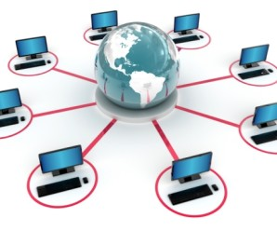
SYSTEM REQUIREMENTS
CONCURRENCY
CONTINUOUS OPERATION
SOFT REAL-TIME
COMPLEX FUNCTIONALITY
HARDWARE INTERACTION
FAULT TOLERANCE

Slide 5

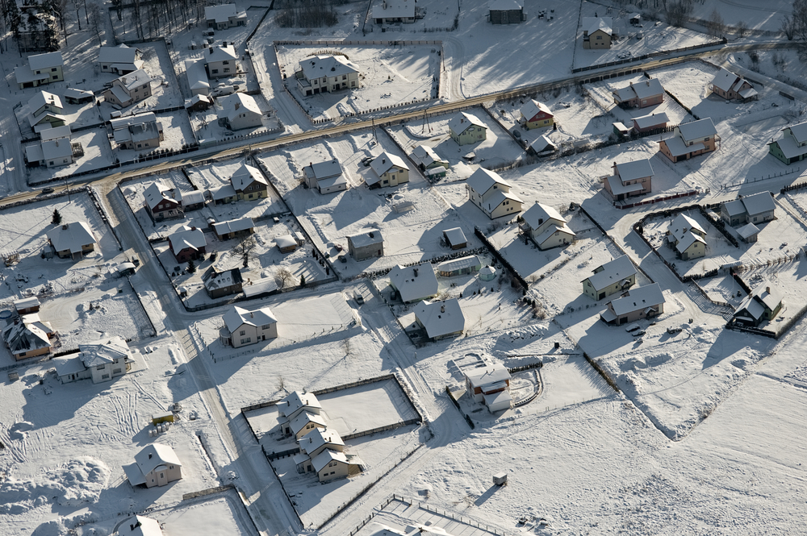
THE PROBLEM SOLUTION
WHATSAPP server has been started from ejabberd.

Slide 6
EJABBERD
Robust, Scalable an Extensible XMPP Application Server
Written in Erlang
Fault - Tolerant
Massively Scalable
Manageable
Very Modular

Slide 7
XMPP
Extensible Messaging and Presence Protocol
Communication Protocol for message oriented middleware based on XML
Developed for near real time messaging, presence information and contact list maintenance
Security : secure authentication (SASL) and encryption (TLS)
Differentiated by JIDs.

Slide 8
OVERVIEW OF ERLANG
Everything in Erlang is process.
Processes are strongly isolated & share no resources.
Process creation and destruction is light weight process.
Message Passing is the only way processes can interact.
Processes are identified by Pids.

Slide 9
ERLANG PROCESSES vs OS THREADS
Implemented in Erlang VM.
Dynamic allocation.
Single threaded.
Implemented at OS level.
Static allocation
Multithreaded.

Slide 10
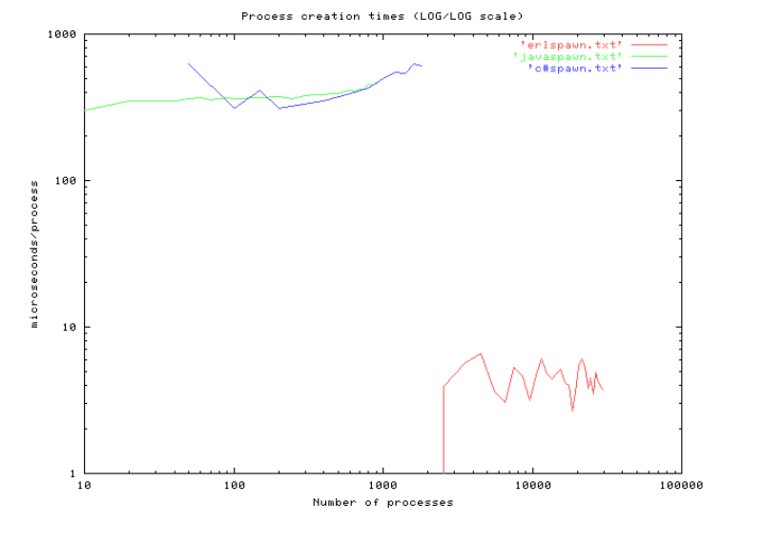
COMPARISON OF ERLANG PROCESSES

Slide 11
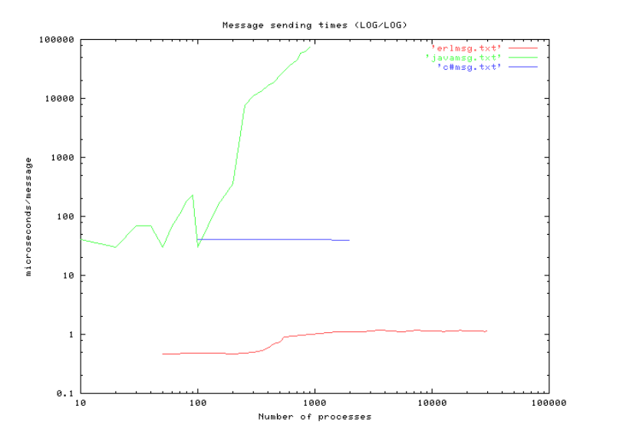
COMPARISON OF MESSAGE PASSING

Slide 12
WHATSAPP STATS
1.2 BILLION MONTHLY ACTIVE USERS AND 50 BILLIONS MSGS EVERY DAY
>70 MILLION ERLANG MESSAGES PER SECOND
$0 INVESTED IN ADVERTISEMENT
DUAL WESTMERE HEX-CORE, 100 GB RAM, FREEBSD, OTP R14B03

Slide 13
BACKEND IMPLEMENTATION
Ejabberd is open source Jabber server written in Erlang.
To handle huge amount of messages, focus is reliable system.
Almost every day, some new code is pushed, Erlang hot loading of code helps a lot in this.
All messages are queued on server until client reconnect and retrieve the messages.

Slide 14
WORK DISTRIBUTION
Need to distribute over 11,000 nodes.
A basic single threaded gen_server is implemented.
>85 % CPU utilization across logical CPUs.

Slide 15
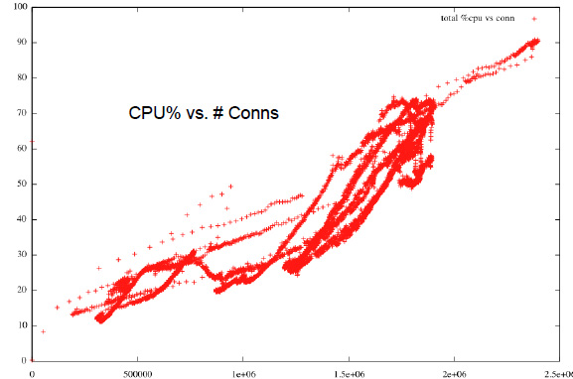

Slide 16

CONCLUSION
ERLANG IS BEST SUITED FOR BACKEND DEVELOPMENT OF MESSAGING PLATFORMS.

Slide 17


Slide 18
THE END

